Slide 1
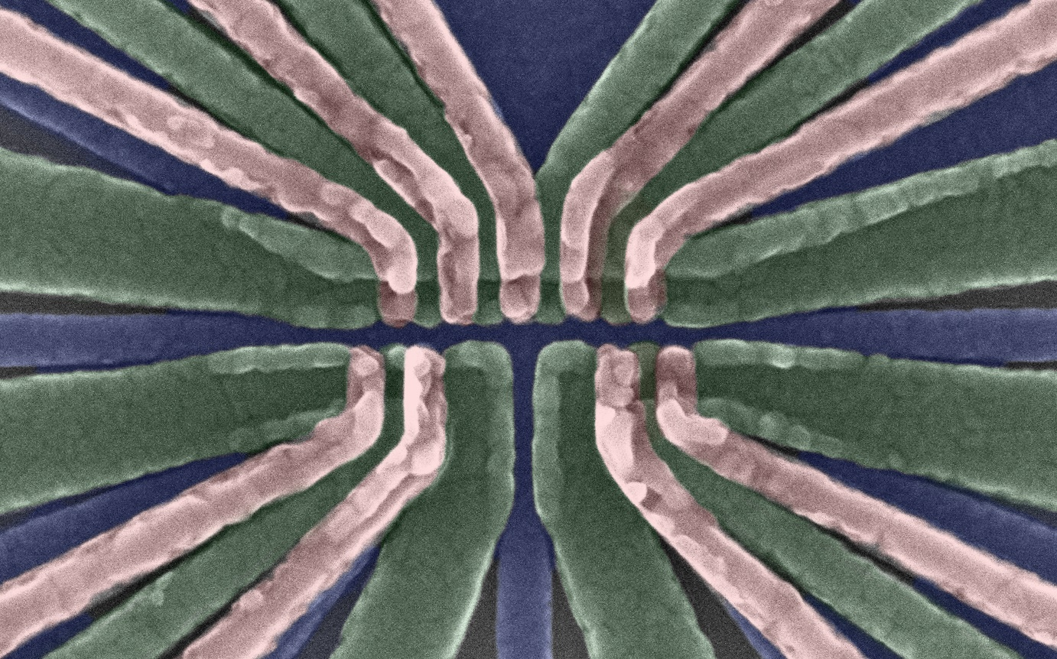
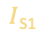
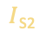
Engineering high-fidelity gates in silicon quantum processors
P₁
B₂
P₂
B₃
TS
P₃
B₄
P₄
B₁
B₅
D₃
e⁻
e⁻
S₃
MS
MS
S₁
$I$_{S1}
$I$_{S2}
S₂
BS₁
300 nm
BS₂
R₂
L₁
M₁
R₁
D₁
MS
D₂
L₂
M₂
Nima Leclerc (nleclerc@seas.upenn.edu), PhD Student
Sigillito Lab
Electrical and Systems Engineering Colloquium, University of Pennsylvania
October 22, 2021

Slide 2
Therapeutic drug design for COVID-19
No drug
With drug
J. Phys. Chem. B 2020, 124, 8201−8208
npj Quantum Information 7.1 (2021): 1-5.
Notes:
-Solving this problem with DFT or HF (no approx.) ➔ computational space of 2^(350) for [string of 100 amino acids] (to compute binding energies, reaction rates, etc).
-Computationally intractable
-Need a better way
-Relying only on approximate methods isn’t enough

Slide 3
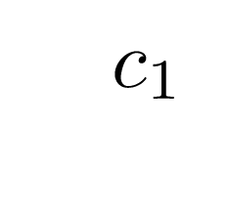
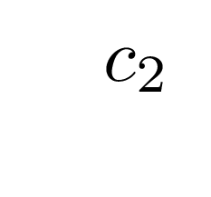
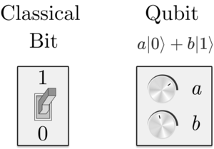
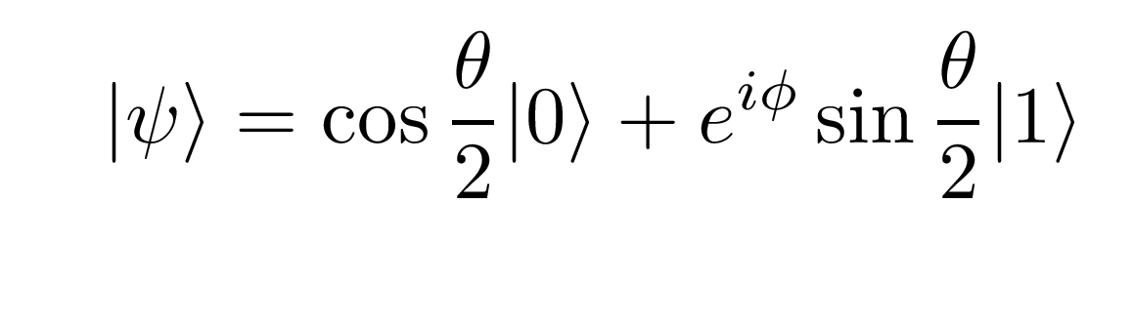
Increase computational space with different encodings
Bits = deterministic
Qubits = probabilistic
➔ probabilities of being in
|0> and |1> states.
Notes:
-Emphasis on computational space here (classical vs. quantum)
-Begin discussion on qubit vs. classical bit
-Can we increase the size of our computational space using different types of bit?
Note: start with “quantum computers are different, can be more complex than ‘0’ and ‘1’. Can be represented on a bloch sphere”

Slide 4
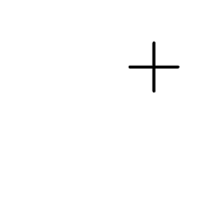
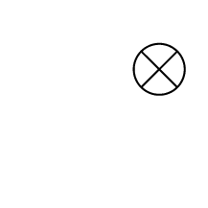
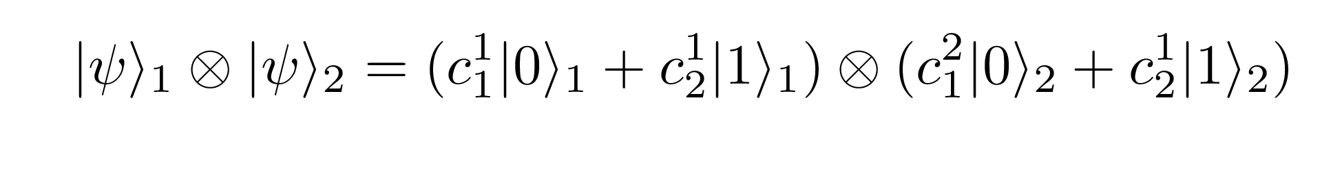
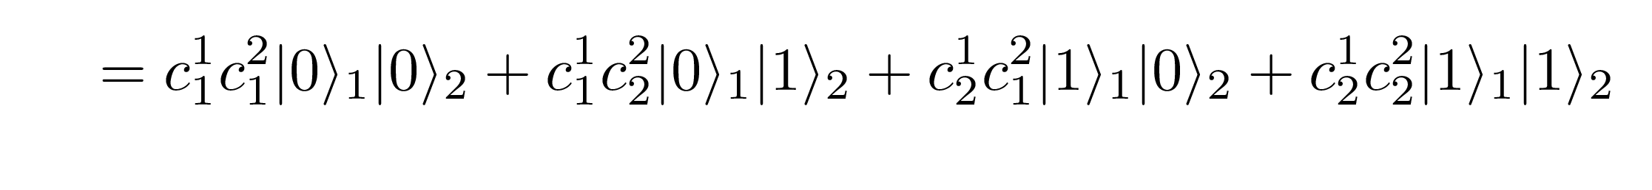
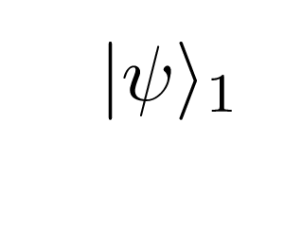
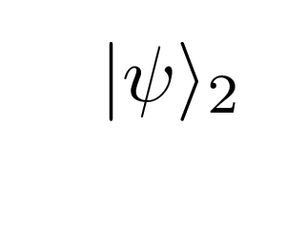
Increase computational space combining multiple qubits
Classical
'1’
‘0’
'1’
‘0’
Quantum
Bit 1
Bit 2
2 computational states from 2 bits
Qubit 1
Qubit 2
4 computational states from 2 qubit ➔ 4 states for each qubit pair
Notes:
-Classical ‘0’ and ‘1’ states ➔ limited computational space. (Protein folding problem will require ”N” bits’
Takeaway here: large computational space from combining two states ==> unique to quantum information.
-Mention entanglement
Note: 2 qubits- each state requires 4 numbers. Need 4 numbers to describe a single state.

Slide 5
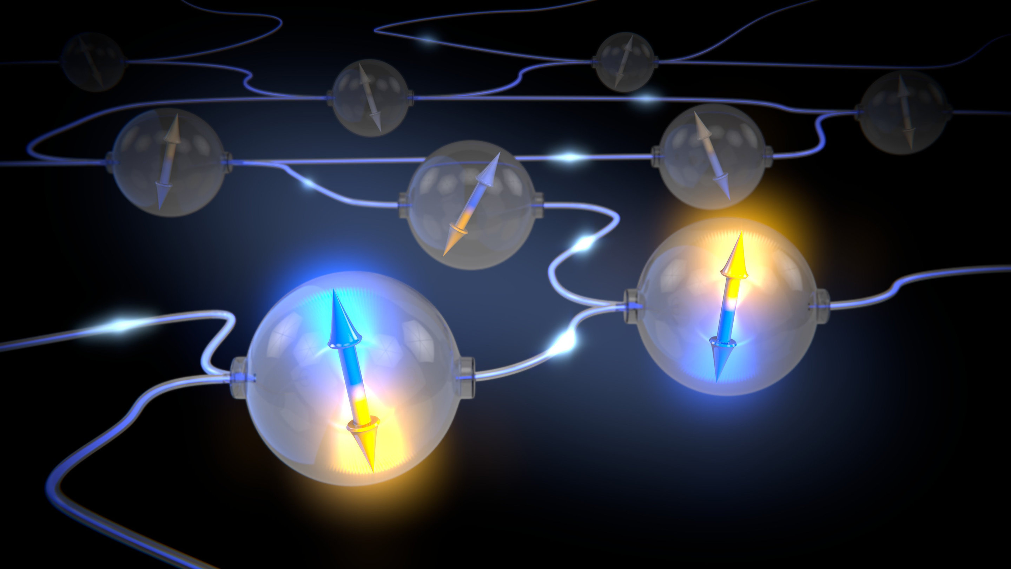
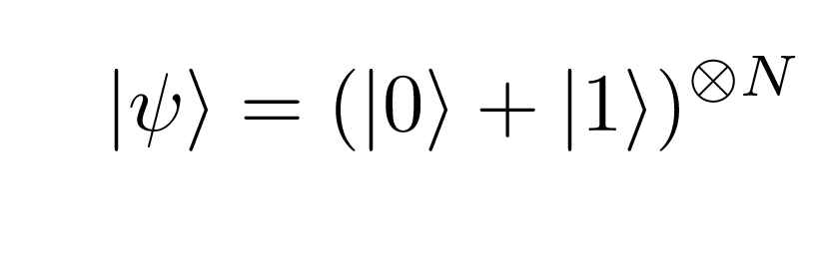
Encoding information in correlations
‘spooky action at a distance’ ➔ entanglement
Information is stored in the correlation between states ➔ exponentially increased computational space
N = 30 (IonQ machine) ➔ ~ 1 GB classical transistors
N =50 (Google machine) ➔ ~ 8,000 TB classical transistors
N =800 ➔ > number of atoms in
the universe to encode information !!
N ➔ number of
physical qubits
Notes:
-emphasize on entanglement generates correlations between states ➔ exponentially large Hilbert space

Slide 6
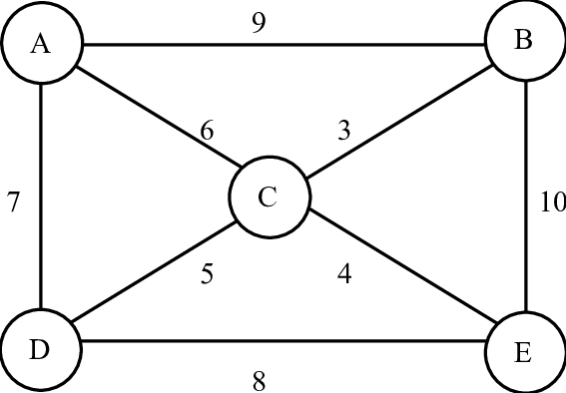
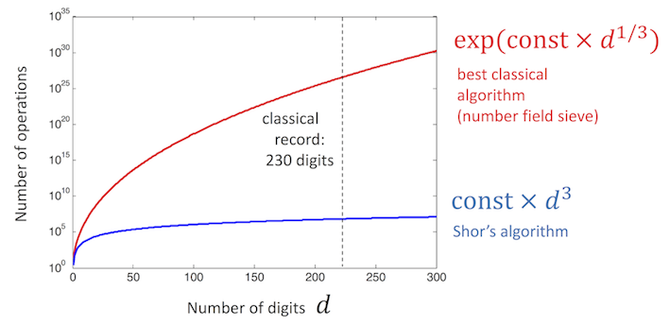
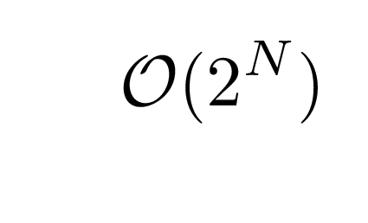
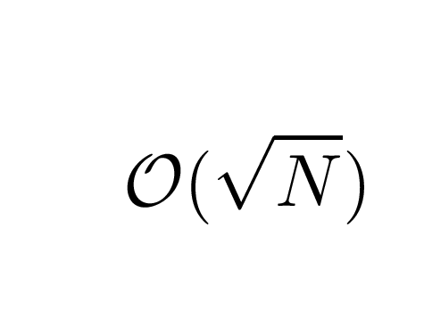
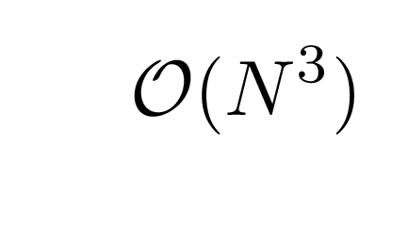
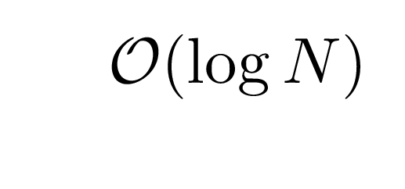
Entanglement encoding for drug design and other applications
Optimization
Search algorithms
Factoring
Quantum Fourier transform
Protein folding
Quantum simulation
Classical algorithm (MTZ):
Classical algorithm (NFS):
Classical algorithm (HF):
Quantum algorithm (Grover):
Quantum algorithm (Shor’s):
Quantum algorithm (VQE):
or
https://quantum-computing.ibm.com/composer/docs/iqx/guide/shors-algorithm
J. Phys. Chem. B 2020, 124, 8201−8208
Notes:
Applications:
(1) drug design [protein folding ([variational quantum eigensolver]) , (2) grover’s search algorithm
(3) Factoring problem
For each: number of qubits necessary
Takeaway: scalability of qubit number is key
Complexity for each: classical vs. Quantum

Slide 7
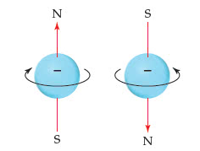
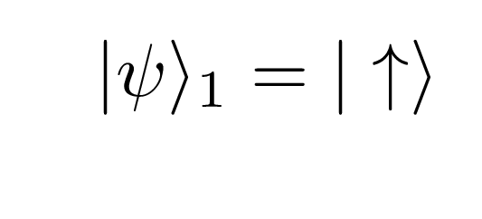
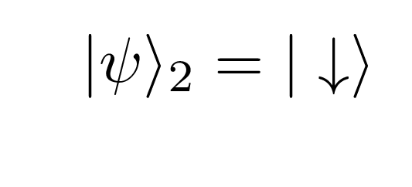
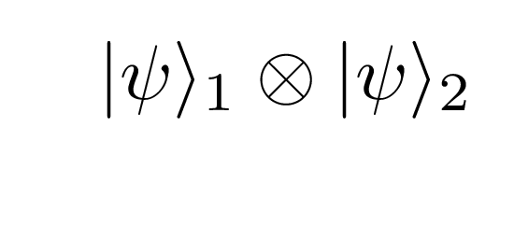
Encoding quantum information in a physical system: small magnets
Magnetic field
Electric field
Photons
Notes:
-quantum state encoded in some 2 level system
-Needs to be probabilistic
-Need to be able to initialize, control (single and pairs) , and readout
-Exchange interaction couples two spins ➔ entanglement

Slide 8
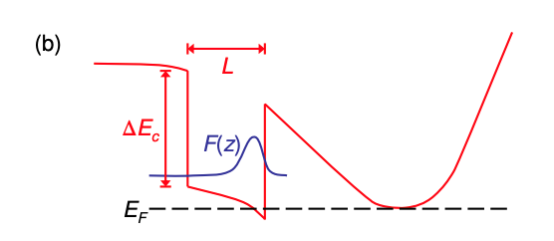
Trapping single spins in semiconductors
Silicon (2 nm)
Si_{0.7}Ge_{0.3} (50 nm)
e⁻
e⁻
²⁸Si (5 nm)
Si_{0.7}Ge_{0.3}
Silicon
2D electron gas (2DEG)
Band diagram from: Friesen et al., PRB 75, 115318 (2007)
Notes:
-now realize a semiconductor heterostructure of Si/SiGe. Creates a confinement potential for electrons
-Forms structure like in the right, triangular potential well (quantum well) ➔ electron localization
Note: ”strained quantum well” ➔ leads to kink in E_c .

Slide 9
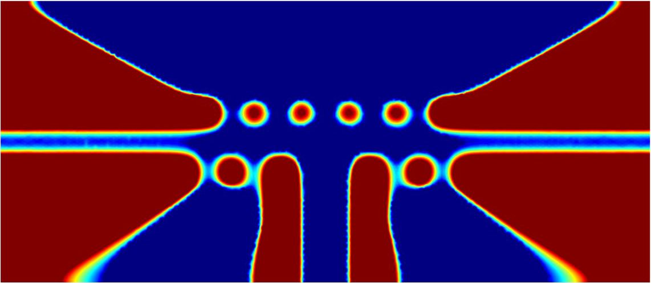
Trapping single spins in semiconductors
B₁
B₂
B₃
B₄
B₅
n (10¹¹ cm⁻²)
P₁
B₂
P₂
B₃
TS
P₃
B₄
P₄
S₃
P₁
P₂
P₃
P₄
D₃
B₁
B₅
0
Si_{0.7}Ge_{0.3}
D₃
S₃
1
2
3
4
²⁸Si QW
e⁻
e⁻
e⁻
e⁻
MS
MS
S₁
$I$_{S1}
S₂
$I$_{S2}
S₁
S₂
1
2
3
4
Si_{0.7}Ge_{0.3}
BS₁
300 nm
BS₂
R₂
L₁
M₁
R₁
D₁
MS
D₂
L₂
M₂
Voltage gates modify 2DEG potential ➔ trap electrons with high precision
Notes:
-Apply positive voltage gates ➔ electrons attract
-Apply negative voltage gates ==> electrons repel –
-We can observe population in each quantum dot, varying voltage and observing
Note: Explain simulation (not a tune up).

Slide 10
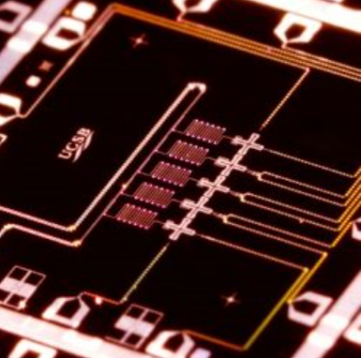
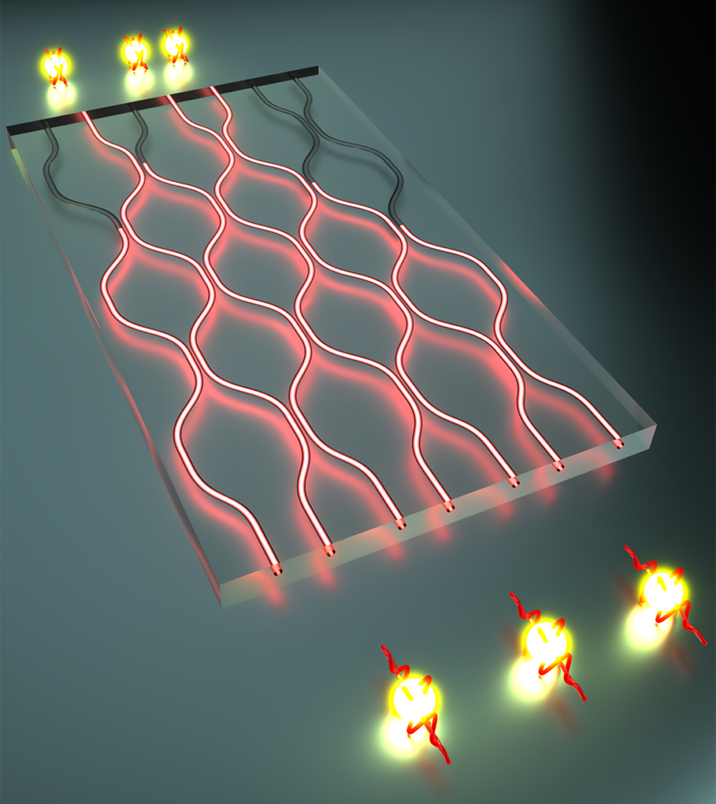
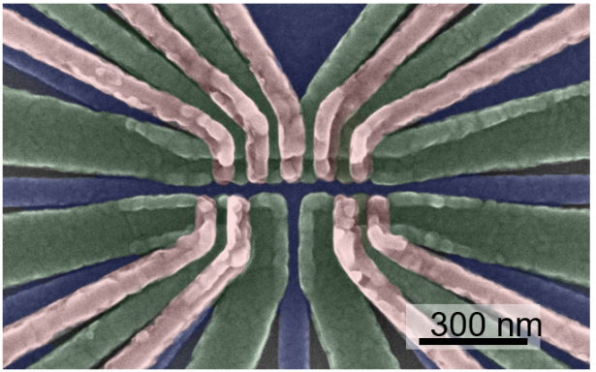
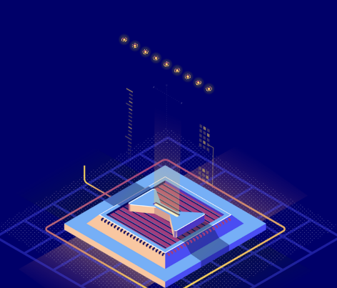
A zoo of quantum computing architectures
Qubit | Superconducting Qubits | Silicon Spin Qubits | Ions/Atoms | Photons
Number Qubits Demonstrated | 72 (Bristlecone) 53 (Sycamore) 50 IBM | 4 | 32 | ~70
Gate Fidelities (2 QB) | 99.9% | >99.5% | >99.9% | >99.5
One qubit gate fidelity | 99.95% | >99.95% | >99.99% | >99.5
Challenges in qubit scalability | Qubit crosstalk dominates, decoherence, too big | Low 2-qubit fidelities, too many wires , too cold | Bulky vacuum systems, soft potential ( weak interaction) | Cannot reliably produce photons, difficult to mediate interaction
Images from: Martinis Group/Google, IonQ, PsiQuantum
Notes:
-Mention that we care about: (1) single and 2 qubit gate fidelitites and (2) potential for scalilbity to solve the problems mentioned earlier
-For each architecture: (1) mention how information is enocoded, (2) fidelities, (3) challenges [and companies involved]

Slide 11
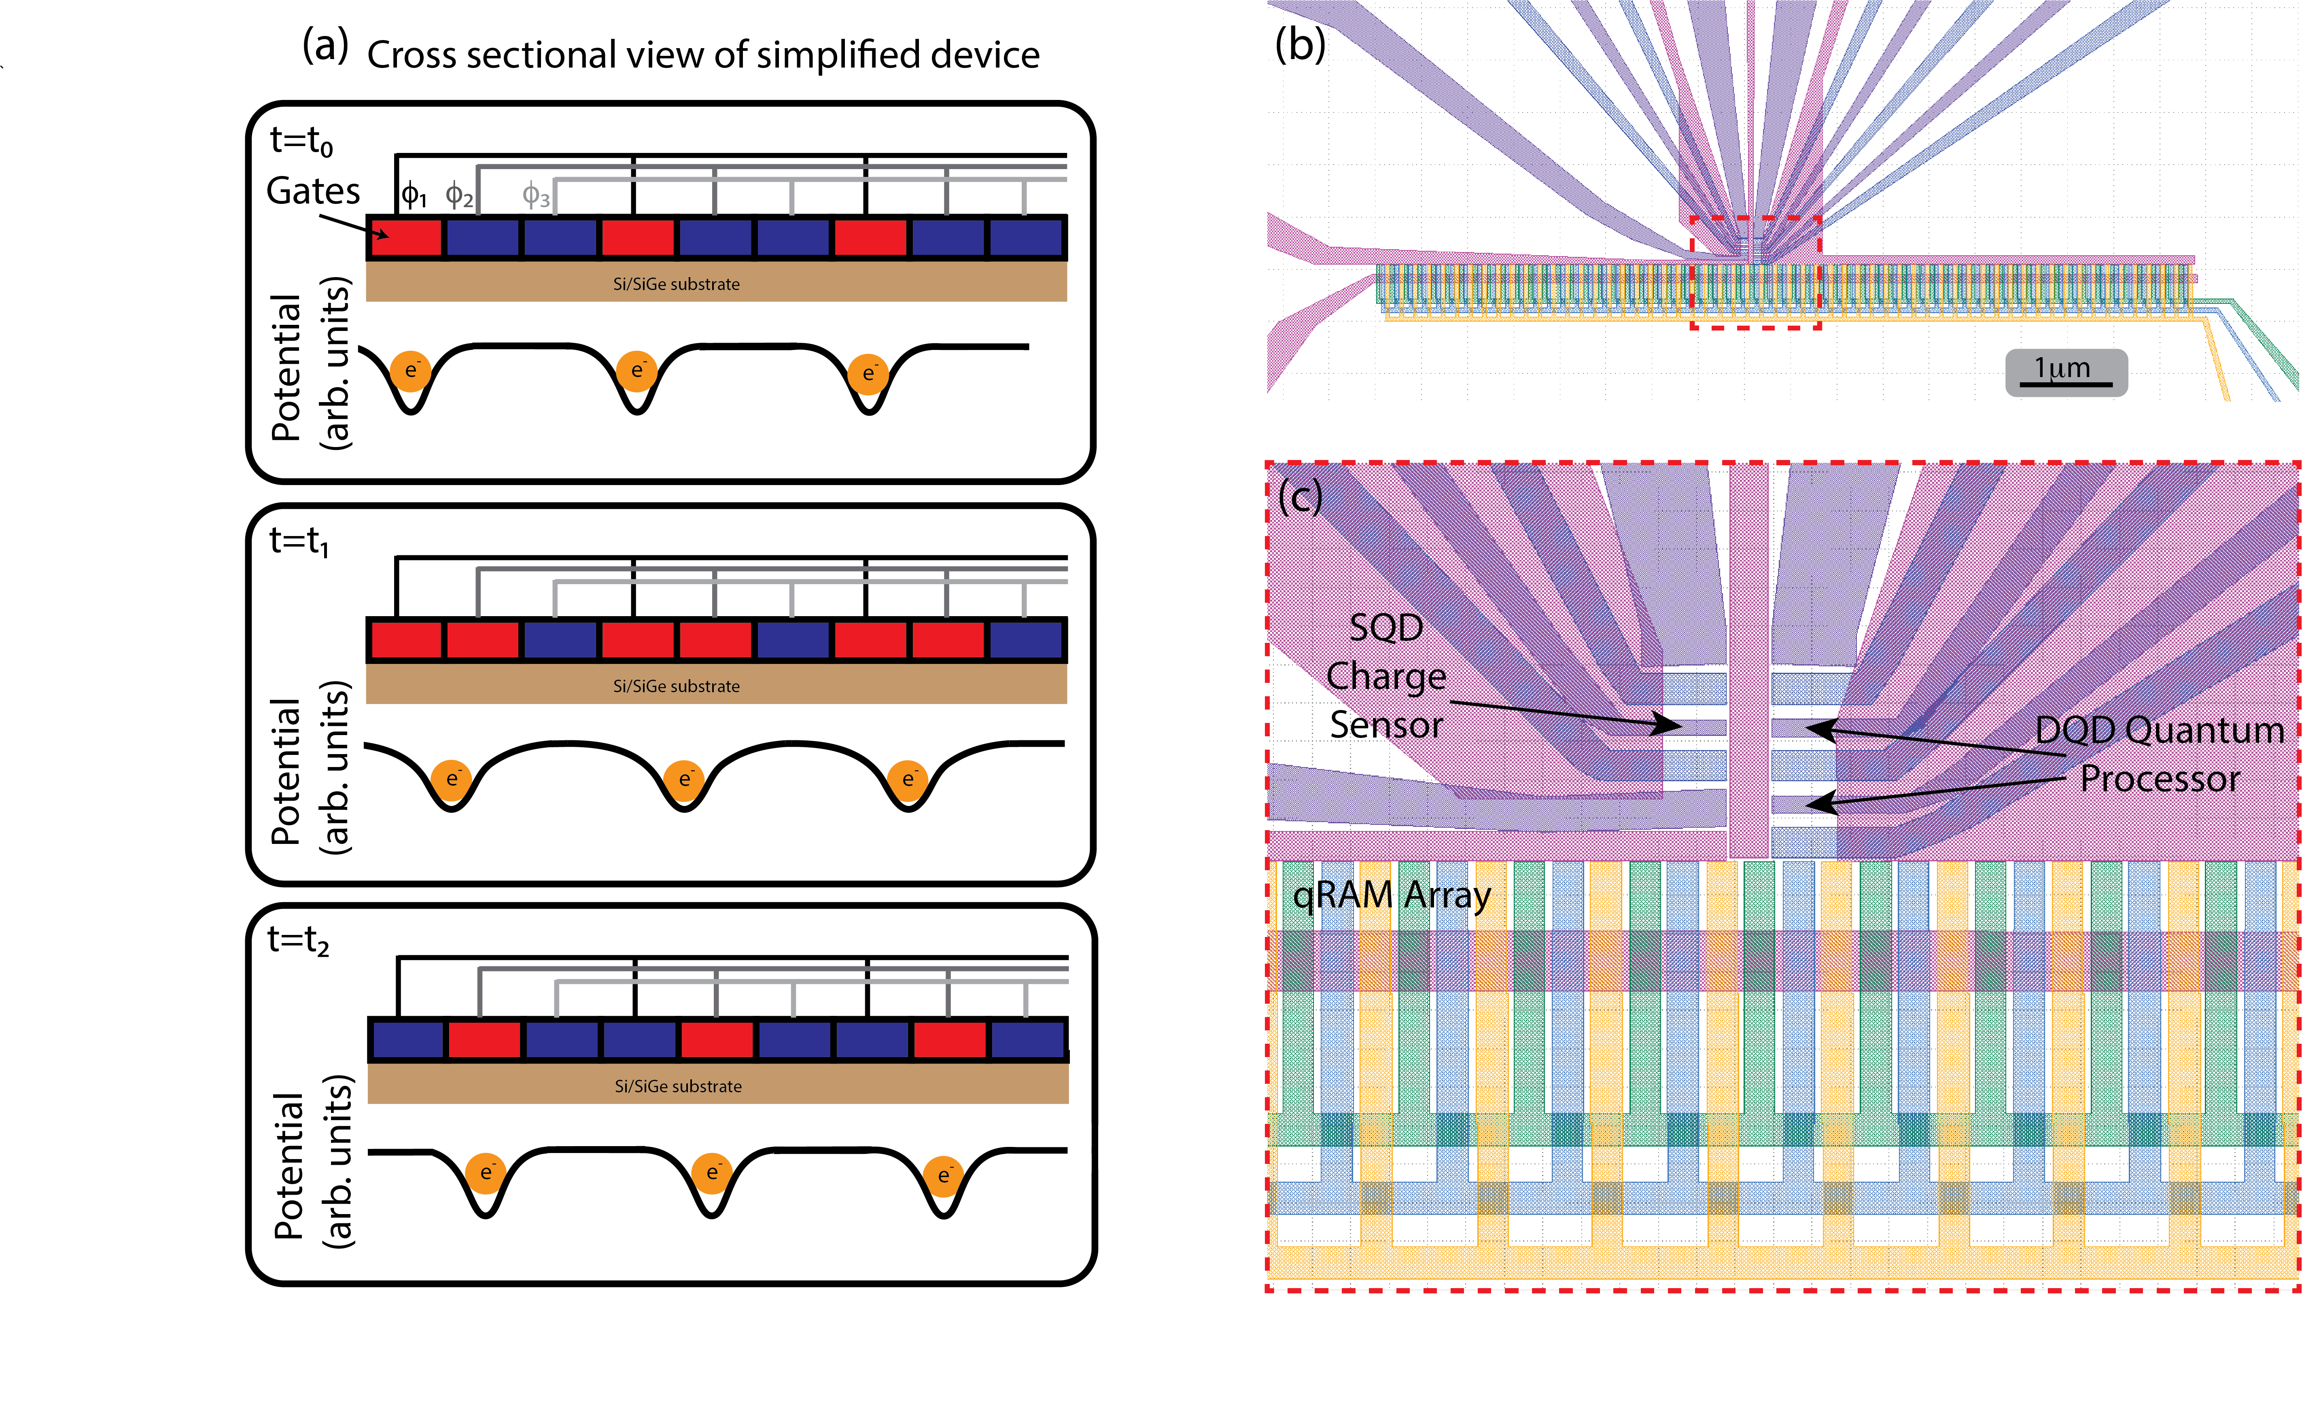
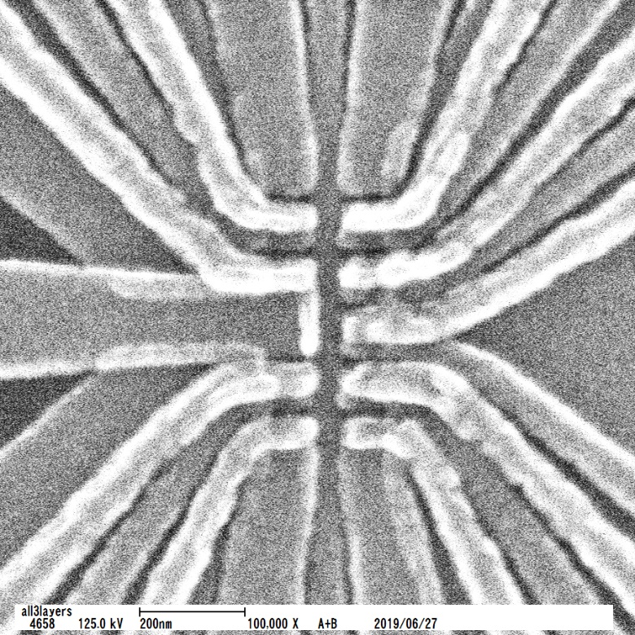
Towards an intermediate scale silicon quantum computer
Challenges | Proposed solution
Low-connectivity Spins limited to nearest-neighbor interactions Difficult to form large cluster states | Quantum random access memory
Complexity Each qubit requires multiple wires connected to bond pads Simultaneous voltage + MW control | Overlapping gate architecture ➔ all qubits share same barrier voltage
Qubit infidelity -Decoherence induced ➔ spin-spin interactions lead to information loss - Noise induced ➔ charge noise leading to fluctuations in exchange interactions | Pulse engineering for noise induced infidelity. Res-Sqrt(SWAP) gates for decoherence induced.
Notes:
Complexity: enabling factor ➔ using resonant control to apply global fields rather than local fields (operation mode) .

Slide 12
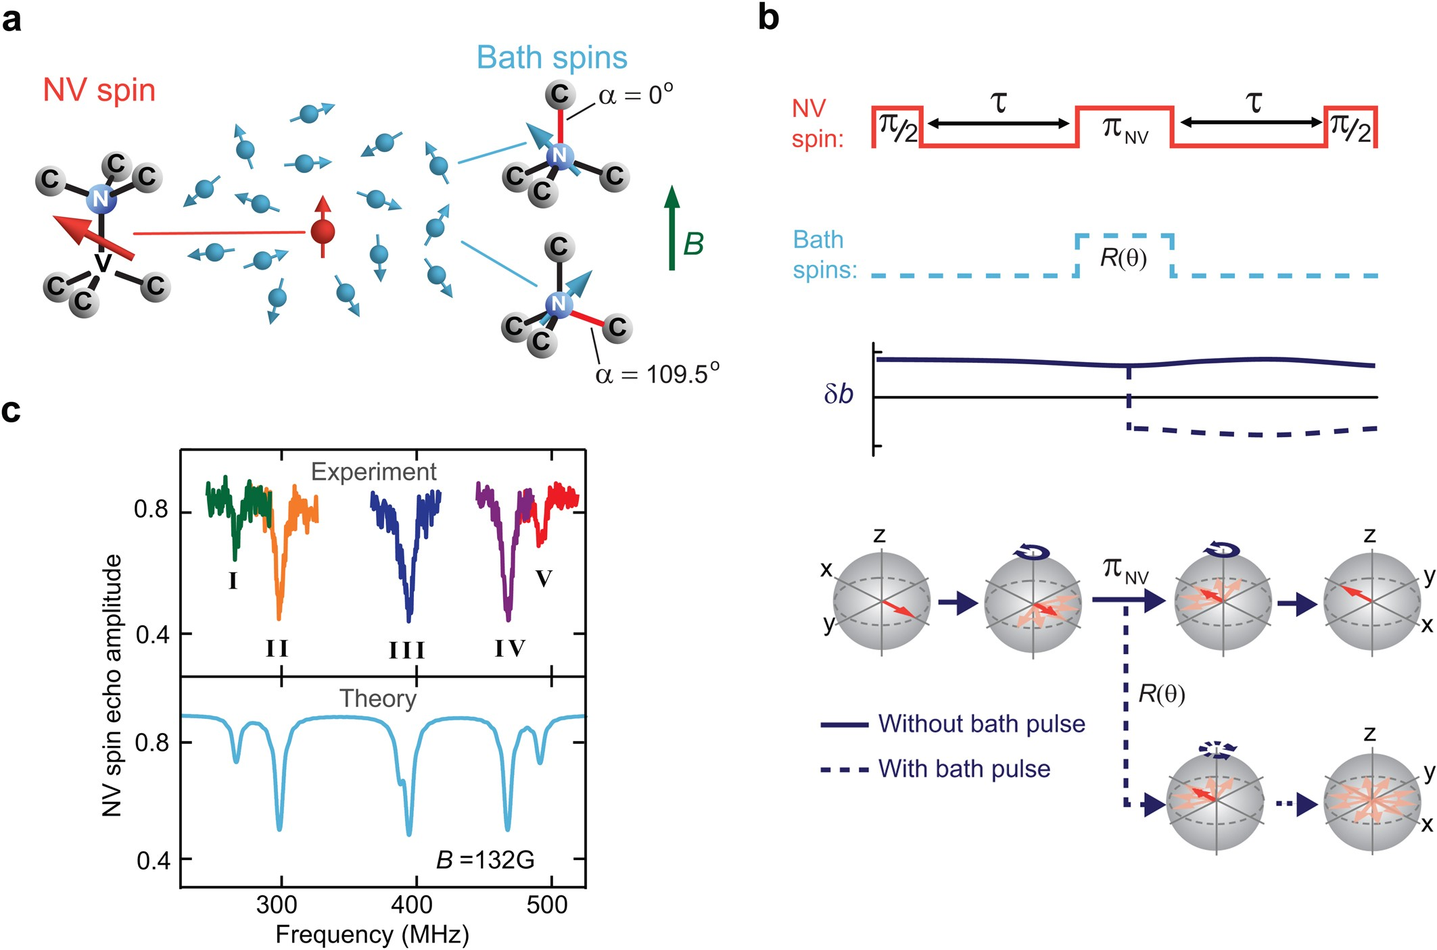
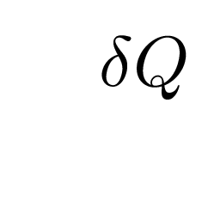
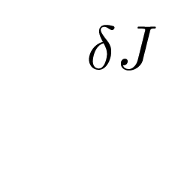
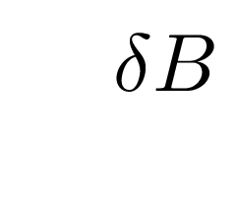
Infidelity in silicon spin-qubit systems: decoherence + noise
Noise
Decoherence
0.7
thermal noise
P_{↑,4}
0.5
0.3
0
5
10
15
20
25
τ (μs)
Sigillito et al., Phys. Rev. Appl. 6, 061006 (2019)
fluctuating charges ( ) ➔
fluctuating surface
magnetic fields
fluctuating exchange ( )
fluctuating magnetic fields
De Lange, Gijs, et al Scientific reports 2.1 (2012): 1-5.
Spins interacting with other spins! (hyperfine coupling)
Nakajima, Takashi, et al. Physical Review X 10.1 (2020): 011060.
Notes:
Note:
Charge noise + hyperfine ➔ decoherence.
Si: 5% Si-29 ➔ 700 ns T2*
Enciched Si-29 (800 ppm Si-29) ➔ 30 us T2*
Plot here: prescence of Ge limits to 10 us (Ge-73, S = 9/2 … 7 %)
Can have high and low freq. charge noise.

Slide 13
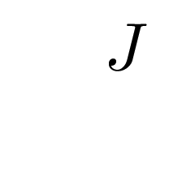
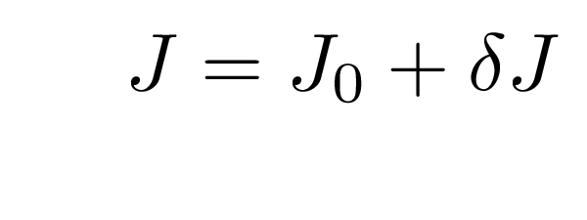
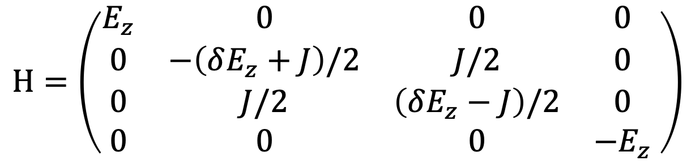
Charge noise induced infidelity
e⁻
e⁻
e⁻
e⁻
Left dot
Right dot
$$H=\left(\begin{matrix}E_{z} & 0 & 0 & 0 \\ 0 & −\left(δE_{z}+J\right)/2 & J/2 & 0 \\ 0 & J/2 & \left(δE_{z}−J\right)/2 & 0 \\ 0 & 0 & 0 & {−E}_{z}\end{matrix} \right)$$
Notes:
Animations of effect of noise on dephasing ==> infidelity

Slide 14
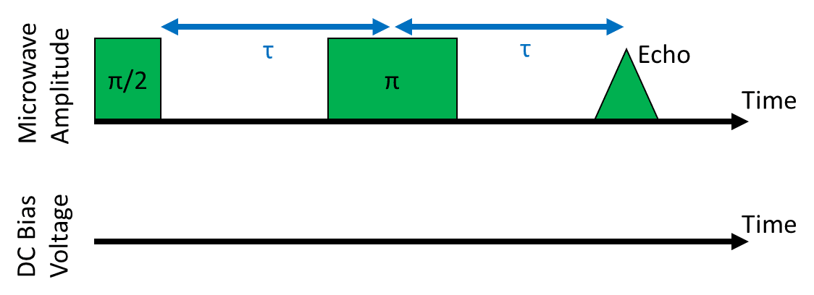
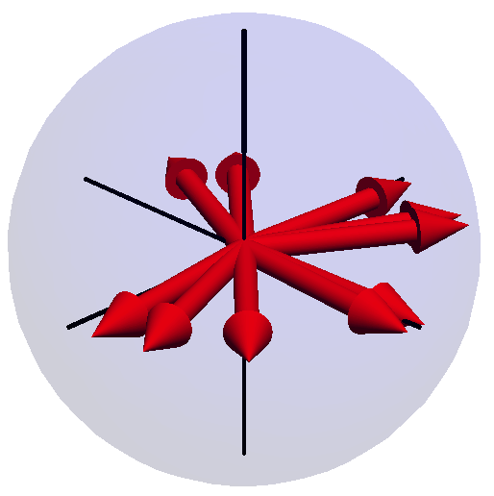
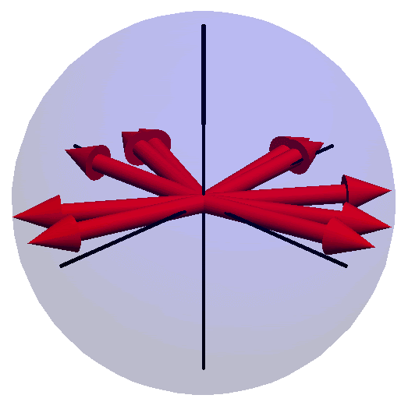
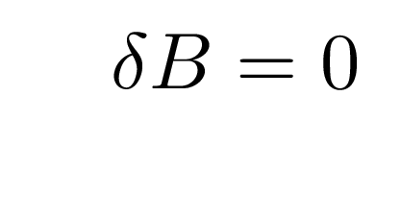
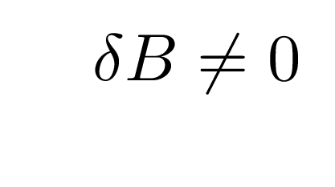
Charge noise induced infidelity (cont’d))
Unperturbed system
Charge noise present
Notes:
Notice:
- under no noise, spin will rotate as we expect over course of Hahn echo
- Under noise, spin will dephase and now be at different point in bloch shphere ➔ charge noise introduces extra phase that we need to account for

Slide 15
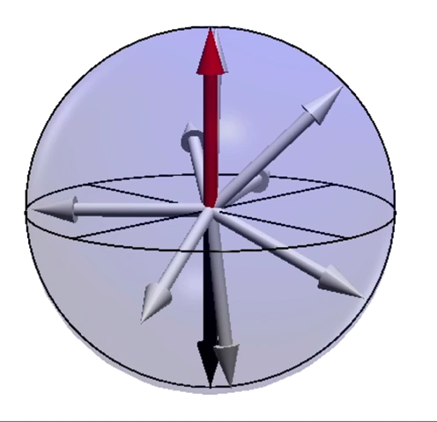
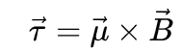
Controlling spins with microwaves
Apply magnetic field orthogonal to B
Needs to be resonant with spins rotating frame
Microwave frequencies
Axis of rotation = phase

Slide 16
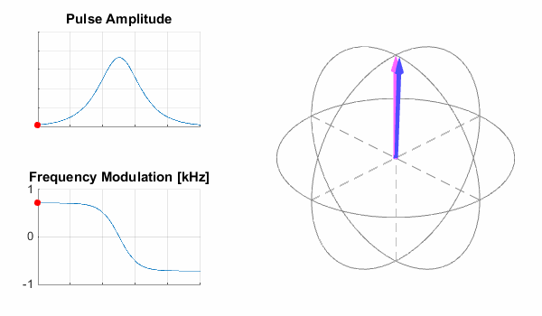
Shaping pulses for noise robustness
http://mriphysics.github.io/teaching-rf-pulses.html
Notes:
-One way of fixing this is developing pulse shapes that are insensitive to noise .
-Adiabatic pulses have been shown to work for this. Here, keep track of pink arrow. We want it to rotate from north to south pole in a controlled manner. If we slowly ‘chirp’ frequency of pulse for a pi rotation, we will force the spin to move down (using a controlled pulse shape). Otherwise, it would rotate in random directions due to noise . Can we engineer this for quantum gates?
Note: mention blue vector is drive field. Applying drive field leads to torque. Torque drives rotation (maybe include e-nutation slide before). Modulating frequency of pulse (chirping) done slowly enough allows us to drag the spin from up to down. [mention this before]

Slide 17
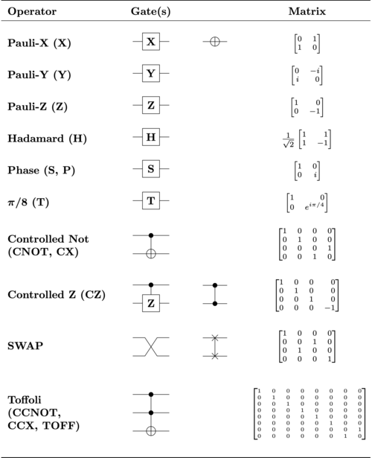
Systematic pulse engineering for single qubit gates
Yang, C. H., et al. (2019): 151-158.
Notes:
-improve single gate fidelities from 99.83 to 99.96 % using optimized pulse shapes
-

Slide 18
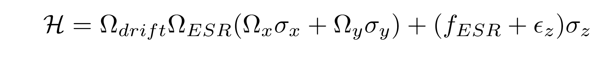

Pulse engineering protocol: gradient based optimization
noise from phase flips
Notes:
-discuss CNOT gate (show diagram)

Slide 19

Extension to 2-qubit gates: CNOT gate
Control
Target
If control = 1, flip target!
Notes:
-discuss CNOT gate (show diagram)

Slide 20









Pulse shaping for CNOT gate
Gradient On
Exchange On
$$δE_{z}>>J$$
B_{Z}
e⁻
e⁻
E$\left(\left.\left|↑↑\right.\right\rangle \right)$
$$f_{\left.|ψ_{R}\right\rangle =\left.|↑\right\rangle }^{L}$$
E$\left(\left.\left|↓↑\right.\right\rangle \right)$
$$\text{E}\left(\left.\left|↑↓\right.\right\rangle \right)$$
$$f_{\left.|ψ_{R}\right\rangle =\left.|↓\right\rangle }^{L}$$
Zajac, AJS et al., Science (2018)
Russ, AJS et al., PRB (2018)
E$\left(\left.\left|↓↓\right.\right\rangle \right)$
Notes:
Note: mention CNOT gate is (1) turning on exchange and (2) driving freq. selective transition . Include pulse sequence here, easy to shape RF drive.

Slide 21

Pulse shaping for CNOT gate (cont’d)
Gradient On
Exchange On
B_{Z}
e⁻
e⁻
+
E$\left(\left.\left|↑↑\right.\right\rangle \right)$
$$f_{\left.|ψ_{R}\right\rangle =\left.|↑\right\rangle }^{L}$$
E$\left(\left.\left|↓↑\right.\right\rangle \right)$
$$\text{E}\left(\left.\left|↑↓\right.\right\rangle \right)$$
Optimized res-CNOT gate as first 2-gate demonstration,
many more to come!
$$f_{\left.|ψ_{R}\right\rangle =\left.|↓\right\rangle }^{L}$$
E$\left(\left.\left|↓↓\right.\right\rangle \right)$

Slide 22
Outlook: towards therapeutic drug design using quantum
Challenges | Proposed solution
Low-connectivity Spins limited to nearest-neighbor interactions Difficult to form large cluster states | Quantum random access memory
Complexity Each qubit requires multiple wires connected to bond pads Simultaneous voltage + MW control | Overlapping gate architecture ➔ all qubits share same barrier voltage
Qubit infidelity -Decoherence induced ➔ spin-spin interactions lead to information loss - Noise induced ➔ charge noise leading to fluctuations in exchange interactions | Pulse engineering for noise induced infidelity. Res-Sqrt(SWAP) gates for decoherence induced.
??
Will need hundreds of qubits!
Notes:
QRAM, etc.

Slide 23



Acknowledgments
ESE PhD Association!
Prof. Anthony Sigillito
Dr. Seong Oh
Notes:
Notice:
- under no noise, spin will rotate as we expect over course of Hahn echo
- Under noise, spin will dephase and now be at different point in bloch shphere ➔ charge noise introduces extra phase that we need to account for

